Slide 1



Static and non-static
Đinh Văn Dũng
HCMC University of Technology And Education

Slide 2
STATIC KEYWORD

Slide 3
Static
Is use to for memory managerment mainly.
Is use to define resources of class.
The static keyword belongs to the class, not to the instance of the class.
apply for static key in java :
Variable
Method
Block code
Nested class

Slide 4
Static variable
Static variable is a class variable
When you declare a variable as static, that variable is called a static variable, or a static variable.
public static int min (int a, int b) { // trả về giá trị nhỏ hơn của a và b }
Static variables get memory only once in Class
Static variables can be used to reference common properties of all objects.

Slide 5
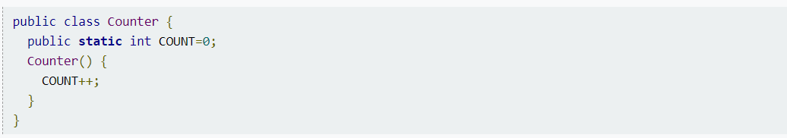
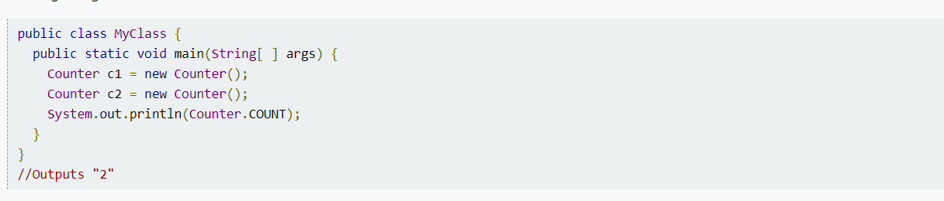
Example :Static applications avariable

Slide 6
Static method
Applying the static keyword to any method, that method is called a static method.
Static methods can’t use instance variables, they usually take input from the parameters , perform some business then return some result.
Static methods can’t invoke a non-static method.
Static methods can’t be overridden.
You can’t use this keyword inside a static method.

Slide 7
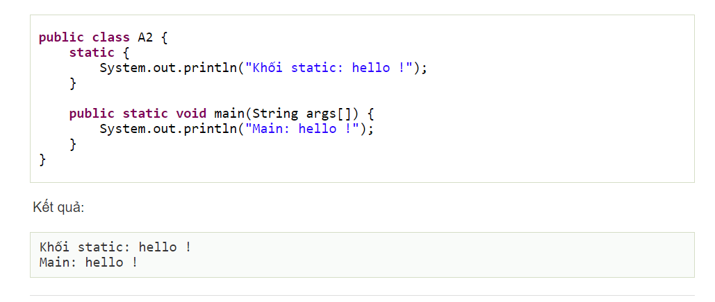
Static block
Used to initialize static data members.
It is executed before the main method at the class load.
Example:

Slide 8
rules to remember
A static method could not use non-static variable or call non-static method
Access static resources via class name or any object

Slide 9
Non-Static methods
A non-static method does not have the keyword static before the name of the method.
A non-static method belongs to an object of the class and you have to create an instance of the class to access it.
Non-static methods can access any static method and any static variable without creating an instance of the class.

Slide 10


